Slide 1
RENTAL SYSTEM
SDP 1 PROJECT
Group Number : 441

Slide 2


Slide 3

TEAM MEMBERS
20XX
2000030270 – EDA MOKSHITA REDDY
2000030433 – KALLAM LASYA
2000031017 – TUBATI LAVANYA MANOGNA

Slide 4

ABSTRACT
This system is designed to help the customers to take bikes or two-wheelers for rent. When we go on any trip outside the town or country, we want to be free of time so instead of going through metros and taxis, we prefer to have our own vehicle for rent.
This system has only one admin account and cannot have more than one admin account. Admin can verify and register the user who is registering. If the admin does not verify, the user cannot register. All other features are explained further in detail.

Slide 5
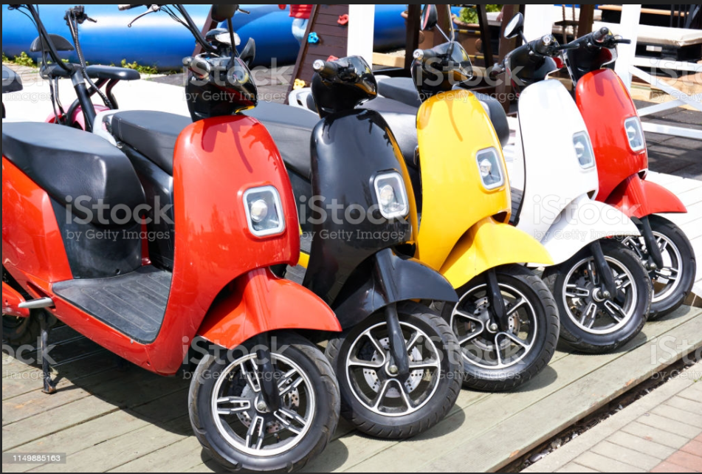
PICTURE SLIDE

Slide 6
SURVEY
We conducted a survey in online through google forms.
We got nearly 50 responses.
Link :
https://docs.google.com/forms/d/e/1FAIpQLSd-wIKuAaObSPk2R1xiMCx1iEe_JaRm7E66uOhKQhXSdchTJw/viewform?usp=sf_link

Slide 7
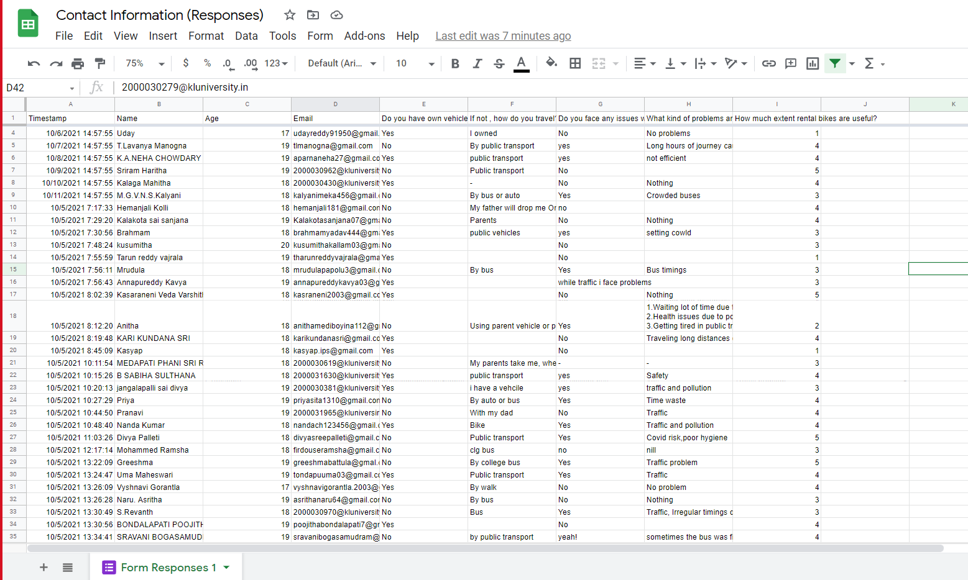
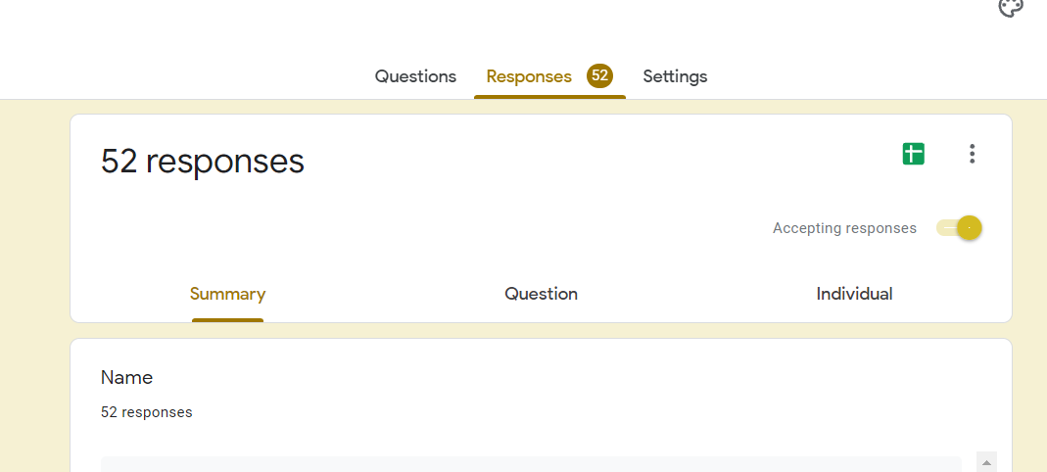
RESPONSES

Slide 8
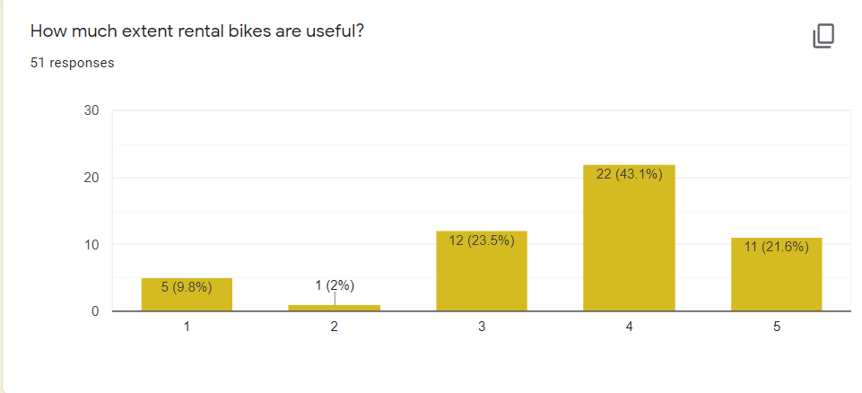
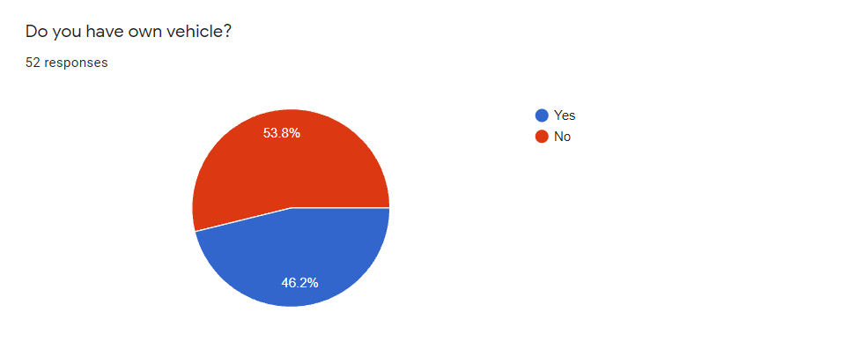
FEEDBACK

Slide 9
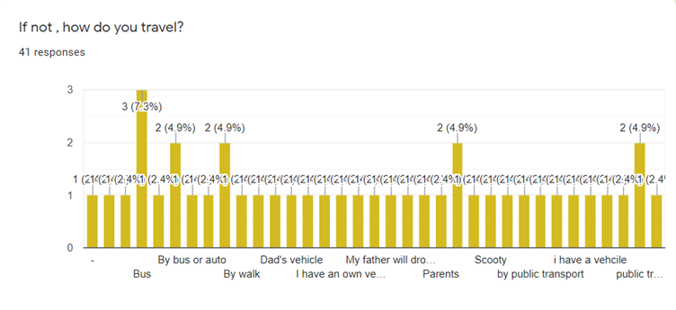
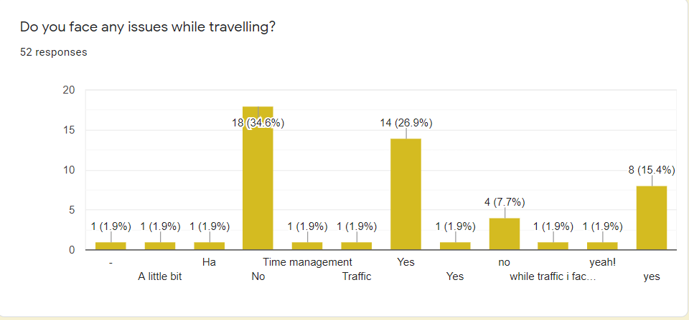
Survey Chart

Slide 10
PERSONA

Slide 11


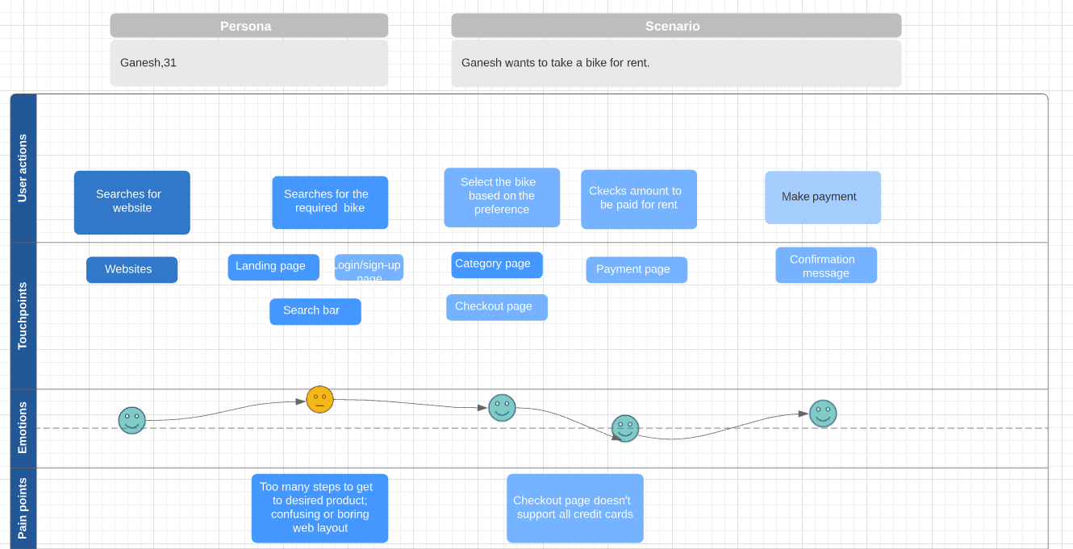


JOURNEY MAP

Slide 12
REQUIREMENT SPECIFICATIONS
Software Specifications:
Technology implemented: Apache Server
Language Used: MongoDB, React.js, Node.js
Database: My SQL
User Interface Design: HTML
Web-Browser: Microsoft Edge, Mozilla Firefox, Google, Chrome.

Slide 13
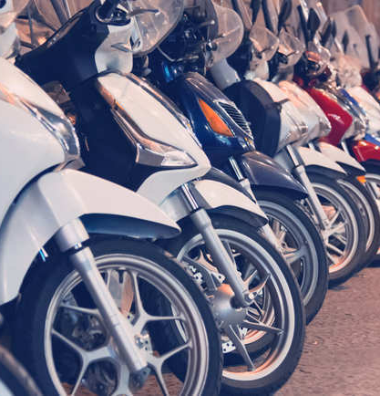
PROBLEMS IDENTIFIED
Waiting longer time for public transport can cause irritation.
People are feeling uncomfortable when traveling in buses.
Poor hygiene while travelling in public transport.
Irregular timings of buses.
People who came from other places can’t bring their own vehicle .So then can use rental bikes.

Slide 14
Modules of Bike Rental System
Our system has two main modules. One is the admin and the other is the user.
User: If the user is a customer, then he can see all the available bikes that he can take for rent.
Bikes: This is one of the most important modules. This module helps the customers to take bike for rent. The status of bikes can be updated as soon as it gets free or it gets booked so that no other customer tries to book the same bike. The information that is added to a bike is its model number, vehicle number.

Slide 15
Login: After registration, one can log in to the system either as the event manager or the customer. The option to register either an employee or customer is given when the user is registering. The interface of this system depends upon the registration. If the user has registered as an employee, then it will have options like arranging all the things as asked by a customer for an event. For the customer, the interface includes the option to check all the available vehicles and their prices.
Admin: This module is present only for one account. That is, no one can register as an admin after one account is created. The admin account has all the privileges, to check about any particular bike details or customer details. To block any account, to update the status about any vehicle, to calculate the payment, to make changes into accounts of users ,etc.

Slide 16
Payment: This module is present so that customers can easily pay the amount as the amount paid through this system goes to admin and then admin can make the payments to all the employess according to their work. The customer can pay the amount through net banking, debit card, or credit card.

Slide 17
USECASE FOR EACH MODULES
User Needs the Bike
To travel the places of short distances User needs bikes to cover the distance in less time.
user
bi
ke
user
needs

Slide 18
LOGIN PROCESS:
To rent the bike he should login to the system module. Thus this page is secured login page for customers in the website.
user
Logins/create
account

Slide 19
availability:
User checks the availability and prices of bikes which they need.
user
checks
availability

Slide 20
Rents:
User selects the bike and makes payments.
user
Selects the bike and makes payment
Through
Card/upi

Slide 21



Login Form Using React.js

Slide 22
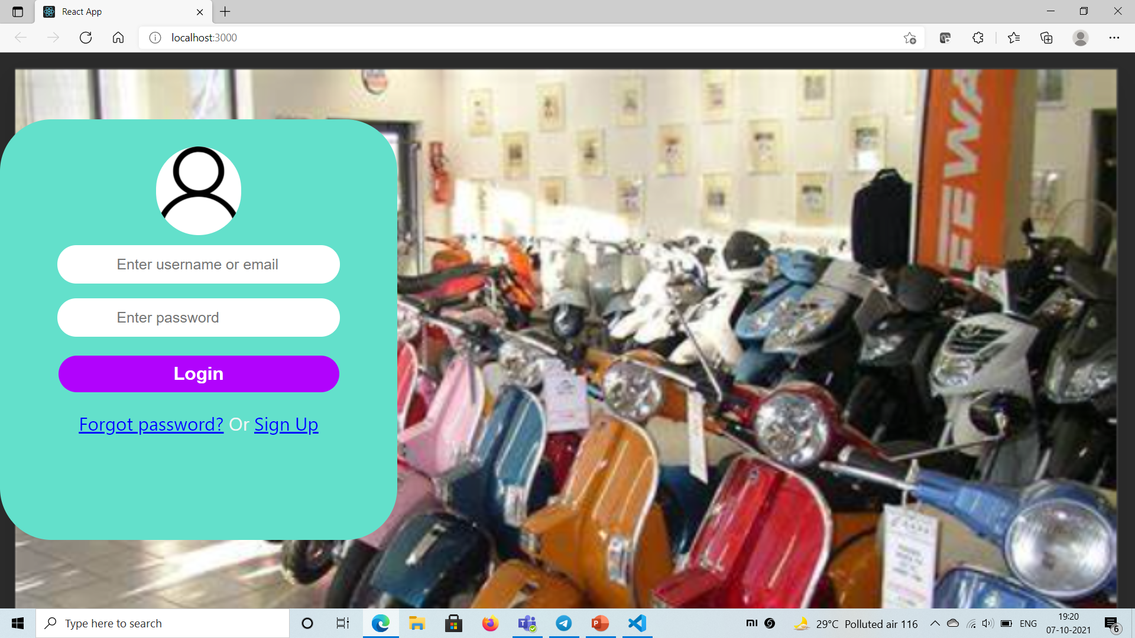

Slide 23

THANK YOU

